Slide 1
EXPLORATORY DATA ANALYSIS (EDA) ON “HOUSING DATA”
Name-Upasna Agrawal

Slide 2
INTRODUCTION
Worked on this dataset-dataset=pd.read_csv(r"C:\Users\agrwa\Downloads\housing_data (2).csv")
Used these libraries -pandas ,NumPy, matplotlib, seaborn.
Overview of the dataset used for house prices analysis.
Purpose of the EDA to identify trends, insights, and data patterns.
Objectives: Data cleaning, visualization, and pattern finding.

Slide 3

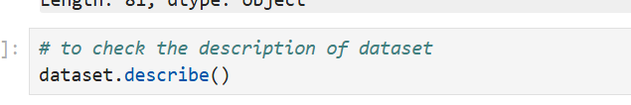


DATA CLEANING AND PREPROCESSING
Description of dataset structure: Number of rows, columns, types of dataset.
To check the column names and count .
To check the dimension of dataset.
To check the null value in dataset.
To check the duplicate value .
To check Zero column value as well.

Slide 4
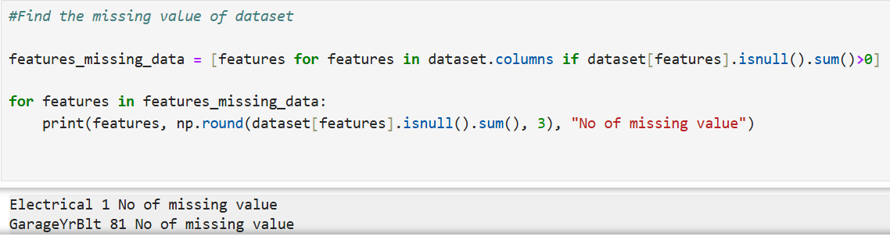
DATA CLEANING AND PREPROCESSING
Key data cleaning steps, such as handling missing values and outliers.
Removing or filling null values and ensuring data consistency.
Check the data type of missing value.
Work of handle missing value by fillna method.
Removing outlier using IQR method.

Slide 5
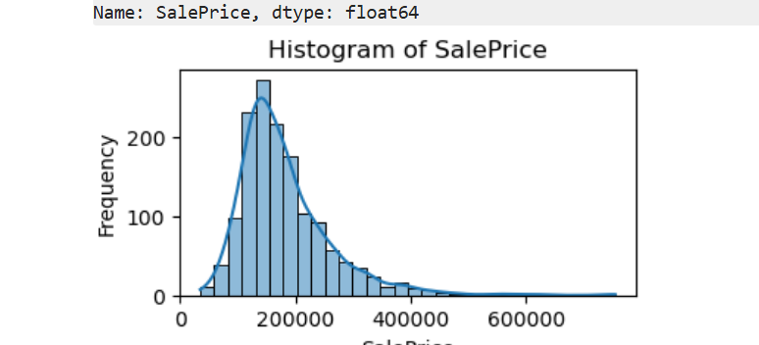
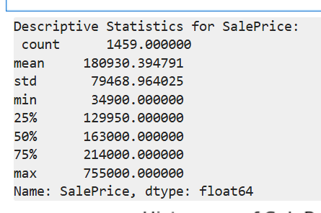
UNIVARIATE ANALYSIS
Univariate analysis involves examining of variable in dataset individually to understand its distribution.
Analyzing a single numeric variable(Sale Price) in a dataset and providing insights into its distribution,
The distribution of sale prices shows that most houses are priced in the lower to mid-range.
Check if the data is normally distributed or skewed.

Slide 6
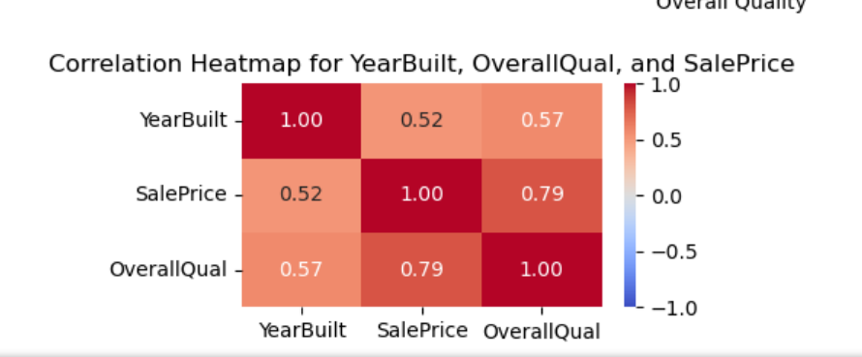
MULTIVARIATE ANALYSIS
Analysis of more than one variable simultaneously to understand relationships and interactions among them.
Analyzing more than one variable(Year Sold, Sale Price, and Overall Quality) in a dataset and providing insights into its distribution.
Used Scatter Plot to visualize the relationship between Sale Price and Over all Qual and Year Built.
The correlation matrix shows the degree to which two variables are related.

Slide 7
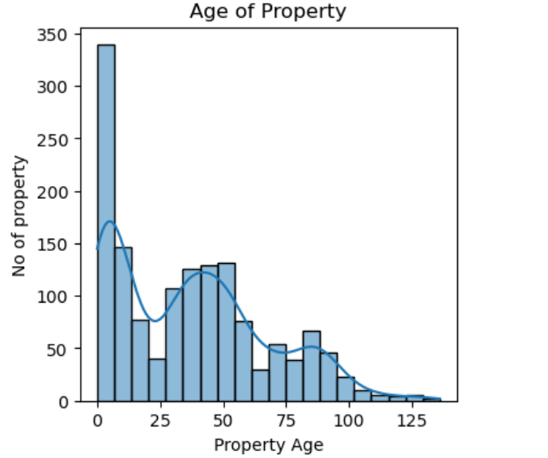
FEATURE ENGINEERING AND SIZE IMPACT:
Feature engineering includes creating new features from existing ones to capture underlying patterns and relationships.
New feature created as Price per Square Foot, total rooms count (combining bedrooms, and total rooms above ground), Age of Property.
Visualization on created feature along with old feature.

Slide 8
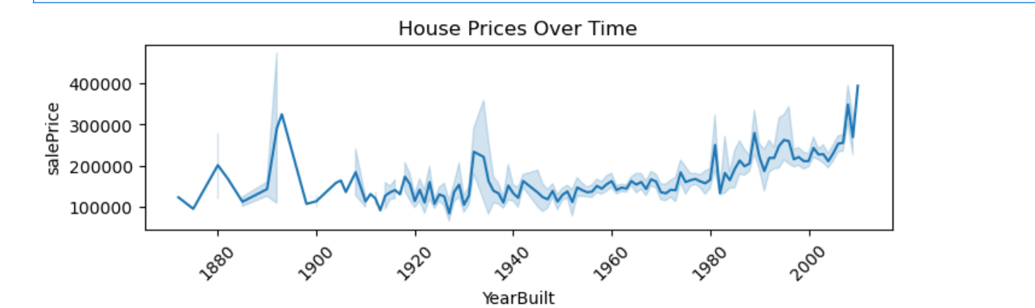
MARKET TRENDS AND HISTORICAL PRICING
To explore how house prices have changed over time.
By this trend we make better-informed decisions regarding property investments or predict future market behavior.
Plotting the monthly and yearly trend of house prices
Line plots help visualize trends in average house prices over time, revealing cyclical behavior and volatility.

Slide 9
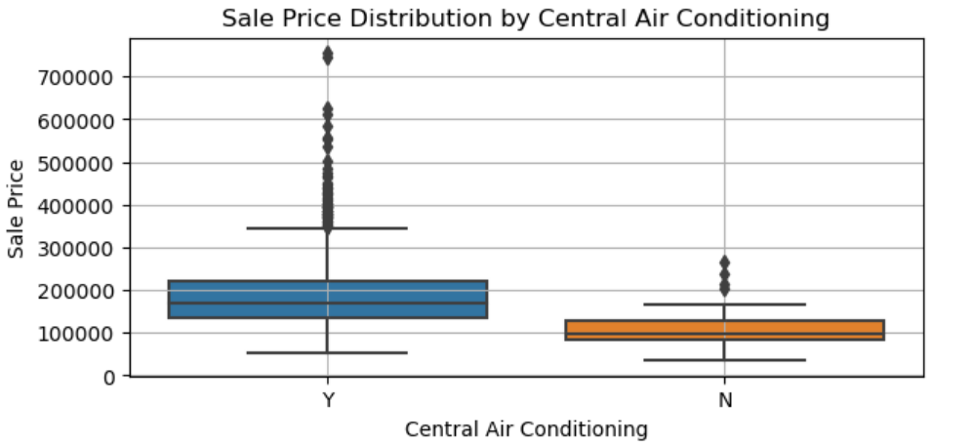
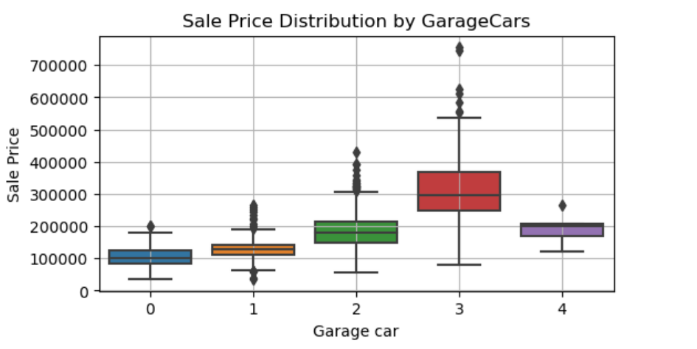
CUSTOMER PREFERENCES AND AMENITIES
Customer preferences and amenities play a crucial role in shaping the housing market.
Visualizing by box plot the Impact of Amenities like Pool, Garage Cars, Air Conditioning .
Features like garages, air conditioning are practical amenities that also increase house prices due to their functionality and convenience.

Slide 10
KEY INSIGHTS AND FINDINGS
Important trends, correlations, or patterns observed in the data.
Summary of findings that could inform further analysis or business decisions
Final insights from the Exploratory Data Analysis.
Potential next steps, such as predictive modeling or deeper feature analysis

Slide 11

THANK YOU

